Slide 1
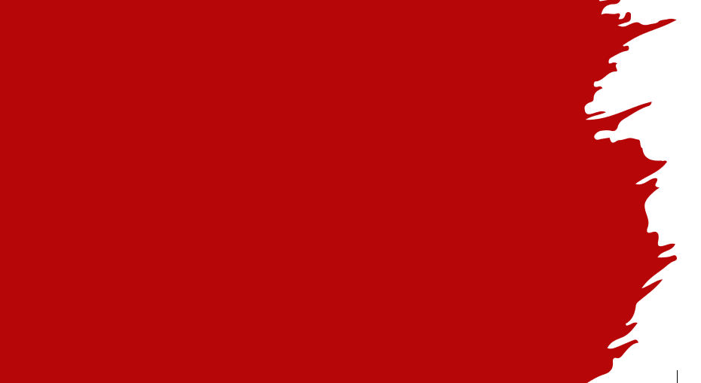

St Alban’s Pupil Council
A.K.A:

Slide 2
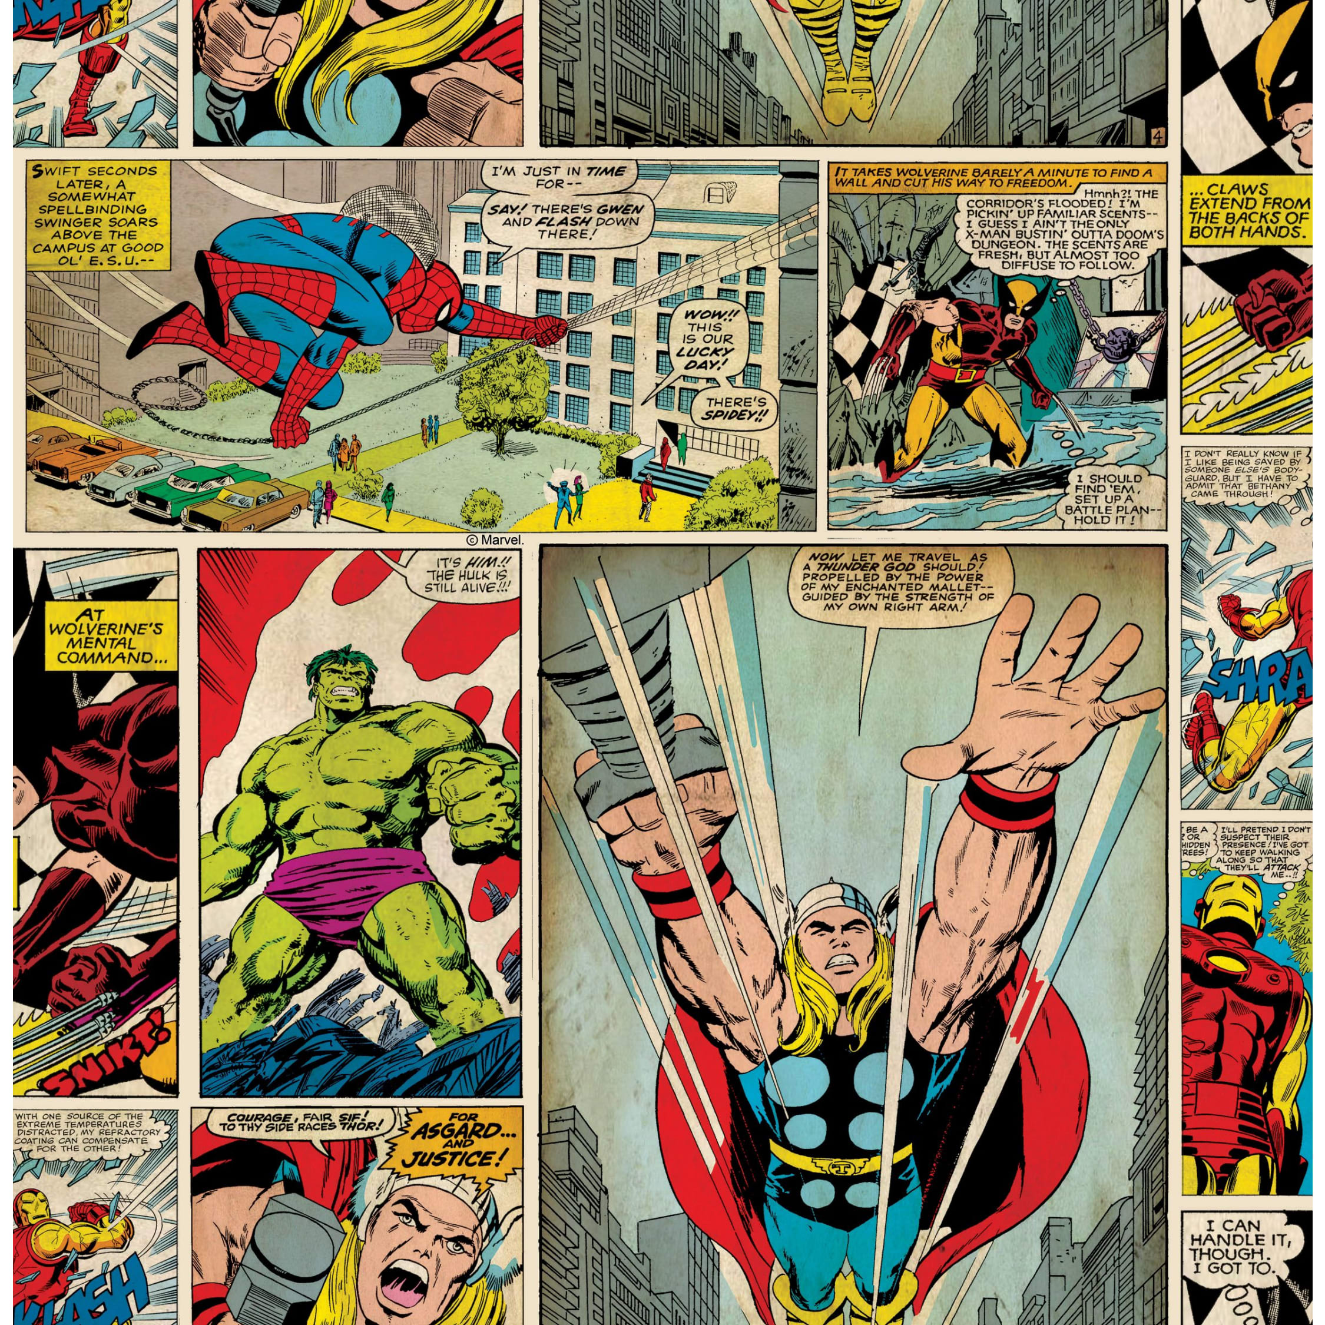
WHO WE ARE:
Hello and welcome!
We are the St Alban’s Pupil Council, more commonly known as ‘The A Team’.
We are a group of pupils, representing the views and opinions of our class mates at bi-weekly meetings with our adult leader.
We have been democratically elected by our classmates, following a written manifesto, campaign and whole class vote.

Slide 3
Our team dedicate our free time to ensuring pupils views are heard. We listen to our class mates, discuss issues and try to resolve these along with our adult leader.
We ensure that pupils ideas and concerns are delivered to the right people.
We are…
Reliable- If you need someone to talk to, we’re here for you!
Proud of our school and want our school to be the best it can be.
Good listeners- We listen carefully to the views of others and take their ideas on board.
Democratic- We represent the majority view of your class, even if we don't agree!
Committed- We dedicate our free time to this role; break times, lunchtimes and after school.
Enthusiastic- We are keen to make our school stand out from the crowd!
Patient- We will listen to your views and respond politely.
WHAT WE DO:

Slide 4
Our incredible A Team members take on an important role within our school community. Here are just a few of the responsibilities they complete as your elected Pupil Council representatives:
Attending regular meetings with other School Council members from each class.
Representing pupils- Voicing ideas and suggestions your class have discussed during meeting times.
Bringing back ideas, information and suggestions to your class and encouraging your class to listen, discuss, share their views and, where necessary, vote on actions that need to be taken.
Helping to organise charity events throughout the year.
Encouraging the pupils in their class to be aware of their school environment and to respect and care for it.
Fund raising for our school and our pupils.
ROLES &
RESPONSIBILITIES:

Slide 5
If you have issues, ideas or suggestions you would like to be discussed during our next A Team meeting…
Speak to one of your A Team representatives
Add a note to the ‘Pupil Voice’ envelopes dotted around school
Speak to the A Team adult leader, Mrs Marshall
Raise your point at the next A Team feedback class meeting
Pass a note to your class representative
ADD YOUR SUGGESTION/CONCERN TO OUR WELLBEING QUESTIONNAIRE
REMEMBER- we are elected BY you, FOR you!
Our job is to represent the views of our children, so make sure you have your say.
PUPIL VOICE:

Slide 6

YOUR ELECTED MEMBERS:
Year 6: Yaseen & Anandjot
Year 5: Millie & Isaac
Year 4: Halima & Sam
Year 3: Aleem & Christiana
Year 2: Nancy & Hawwa

