Slide 1
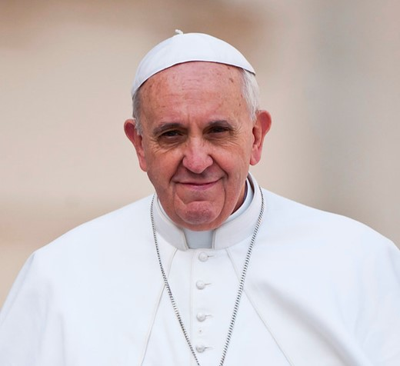



“The world sings of an endless love.
How can we fail to care for it?”
Pope Francis
Notes:
Photo credit: Catholic Church of England and Wales Flickr

